Slide 1

THE CLIENT APP · MVP 1
Intigo, for clients.
The customer-facing app — not the partner or admin tools. This is what a client sees and does.
Track, in real time
Buy water
Built for MVP1
watch the order move + live alerts
one product, two taps
focused, shippable, lean
Executive overview · June 2026

Slide 2


WHAT MVP 1 DELIVERS
Two goals, done well.
GOAL 01
GOAL 02
Real-time tracking & notifications
Buy water from our shop
The client watches the order move and is notified the moment anything changes — the heart of the experience.
One simple product, ordered in a couple of taps and paid cash on delivery. Proves the full commerce loop.
Intigo · MVP1 · clients
02

Slide 3
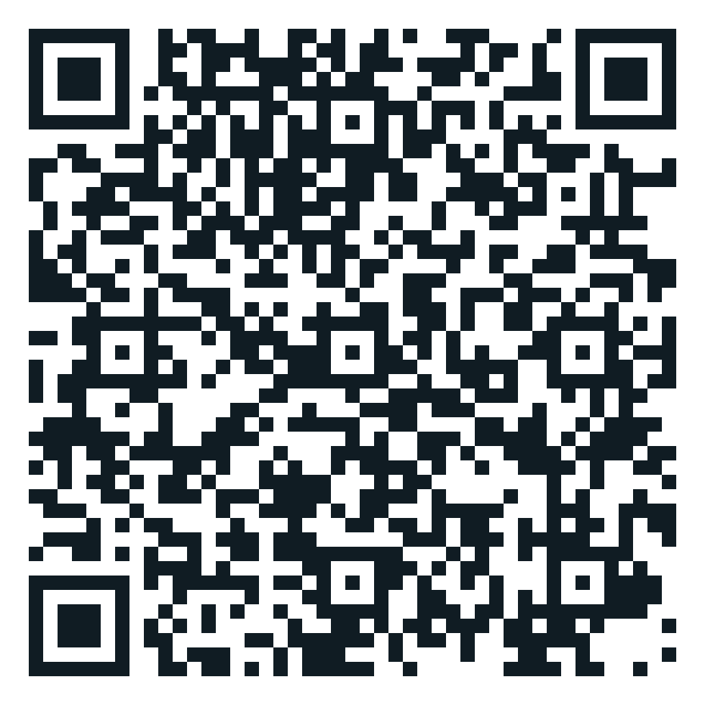
TRY IT NOW · ANDROID
Scan, install, and test it with us.
THREE STEPS
1
Open your camera
point it at the QR code
2
Tap the link
it opens the Play Store
3
Install & sign up
start your first order with us
play.google.com/store/apps/details?id=net.intigo.client
Point your camera here
Intigo · MVP1 · clients
03

Slide 4






FLOW 01 · SIGN-UP
Joining is instant.
1
2
3
4
5
Enter phone
Get a code
Verify
Add profile
Ready
Client types their 8-digit number
A 6-digit code arrives by SMS
Enter the code — identity confirmed
Name, optional email & password
Account active — start ordering
Under a minute, no passwords. Phone-based sign-up removes the biggest drop-off point and works for everyone with a mobile.
Intigo · MVP1 · clients
04

Slide 5






FLOW 02 · ORDERING
Buy water, in a few taps.
HOW AN ORDER WORKS
1
Open our shop
The Intigo shop — water available now
2
Select water
PROMO CODES, BUILT IN
Pick the product and quantity
Client enters a code
3
Fill in details
6 DT 4.5 DT
Delivery address & promo code
4
Validate
Discount shown instantly — the saving is visible before they confirm.
Confirm — pay cash on delivery (COD)
5
Pushed to partner
Cash on delivery keeps it simple — no card, no friction. Every order is tracked from the moment it's placed.
Order lands on the merchant dashboard
placing the order notifies the client instantly — push if registered, else an SMS to download the app
Intigo · MVP1 · clients
05

Slide 6






FLOW 03 · TRACKING — THE HEART OF MVP1
Track the order live.
1
2
3
4
5
On the way
Live tracking
Reschedule or cancel
Arrival alert
Delivered
Order confirmed and dispatched
See status, ETA and the driver
Change the plan from the app
Full-screen notice when driver arrives
Confirm receipt of the order
notifies
notifies
notifies
notifies
notifies
EVERY STATUS CHANGE NOTIFIES THE CLIENT — APP PUSH IF REGISTERED, ELSE AN SMS TO DOWNLOAD THE APP
Live, the whole way. The client is never left wondering where their water is — fewer support calls, more trust, repeat orders.
Intigo · MVP1 · clients
06

Slide 7


GOAL 01 · NOTIFICATIONS
Notified the moment it changes.
ANY ORDER — CREATED OR UPDATED
Shopify
Has an account
PrestaShop
Instant app push — tap to track the order live.
Intigo platform
WordPress
creation + every
status change
Partner dashboard
No account yet
Intigo mobile app
An SMS invites them to download the app and start the journey — following this very order.
every status change fires too
One rule, everywhere: any order — created or changed, from any channel — reaches the client. App push if they're in, an SMS invite if they're not.
Intigo · MVP1 · clients
07

Slide 8




SUPPORTING · ADMIN DASHBOARD
Our team sees everything, live.
Behind the client app, one dashboard lets our team run and watch the whole MVP.
Orders & tracking
Coupons
Every order and its live delivery status, end to end
Create and control promo codes; see redemptions
Users
SMS & messaging
View clients, manage accounts and verification
Manage SMS invites and templates; confirm every push and event was delivered
Intigo · MVP1 · clients
08

Slide 9

RECAP
MVP 1, in one view.
Sign-up
Buy water
Live tracking
Phone + SMS code, under a minute
Our shop, COD, promo codes built in
Watch the order move, reschedule or cancel
Real-time alerts
Admin dashboard
Cash on delivery
Push if registered, SMS invite if not
Team runs and watches the whole loop
No card, no friction
Intigo · MVP1 · clients
09

Slide 10


AFTER MVP1
What comes next.
ON THE ROADMAP
NEXT UP
More products
beyond water — full shop catalogue
Driver & client messaging
Parrainage
in-app chat during delivery
Meeting point on a map
A referral program — clients invite friends and both are rewarded. Turns happy customers into growth.
pick the exact handover spot
In-app wallet
balance, refunds and faster checkout
Intigo · MVP1 · clients
10

Slide 11
LET'S TALK
Questions?
Thank you — and try it with us today.
SCAN TO INSTALL
Android · play.google.com
Live & shipping
Buy water
Built lean
tracking + notifications
one product, COD
focused MVP1
Intigo · MVP1 · clients
By Lamjed GAIDI
11

